Slide 1
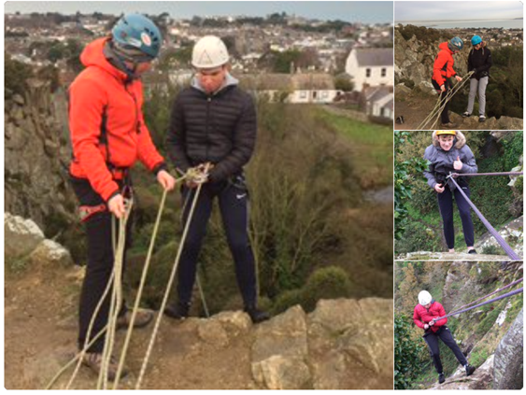
C.B.C. Monkstown Park Transition Year 2018 - 2019

Slide 2
Transition Year
The Core Subjects
Irish
English
Maths
Religious Education
French / German
SPHE
Driver Education
ECDL

Slide 3
Transitioning to the Leaving Certificate
Leaving Certificate Option Subjects
Art
Biology
Business
Chemistry
Classical Studies
Geography
History
Home Economics
Physics

Slide 4
Aptitude Testing and career orientation The Career Guidance Team carries out Aptitude tests at Christmas Examination time to facilitate students & parents in selecting Leaving Certificate subjects aligned with their strengths and preferences Feedback is given to Each student before subject options are made for 5th Year. Students also benefit from careers talks during the year. When a student organizes his Work Experience in a field of possible career interest it can help greatly with career choice clarification.

Slide 5
♦ Public Speaking ♦ Drama ♦ Chinese ♦ Sport Science & Health Education ♦ Politics ♦ Media Studies ♦ Music Production
Transition Year
Transitioning to adult life:
developing new skills and to gain new insights

Slide 6
Social Placement in the community
Each student takes part in a 7-8 week module of social placement.
Placements are in nursing homes, schools, community organisations, etc.
CBC finds placements for its TY students. We would be delighted to hear from parents involved in these areas who know of particular needs in the community and who could suggest new placements.

Slide 7
Garda Vetting
Garda Vetting is required by law for anyone aged over 16 working in most areas of Social Placement.
Parents need to apply for Garda Vetting as soon as possible after the student’s 16th Birthday.

Slide 8
Work Experience
Students have the opportunity to gain experience in work/career areas of interest to them.
Students arrange their own two weeks working in Businesses, Hospitals, etc.
These are invited to give CBC feedback on the student’s performance.
Work Experience 2019
7th - 18th January
Additional Work Experience outside these dates is subject to approval by CBC

Slide 9
What TY students remember
The Musical
Social Placement
Work Experience
Project work
Galway Outdoor Education Centre
Field Trips
Collecting for Charities
Film Studies

Slide 10
What TY students learn
Independent learning
New ways of learning
Self – reliance
Team work
Creativity
Working with those outside their peer group
Responsibility
Problem-solving
Social responsibility

Slide 11
Not to mention…
Schools Rugby
Physical Education
Trips Abroad (Optional)
Special TY Subject Activities
Outdoor Pursuits Week (Connemara)
GAA Coaching
Visits to Theatres, Art Galleries, Museums
First Aid Certification

Slide 12
Transition Year
An Opportunity presented
An Opportunity to be taken
A Transition Year for students … and their parents
End of Presentation

